Slide 1

Date-a-Scientist
Machine Learning Fundamentals
Capstone Project
Daria Borisenko-Orlowski

Slide 2

Dating Apps are Evil
They use sophisticated algorithms to help us find potential matches and send us on disastrous dates we usually regret going on. Let’s see if machines can successfully reduce our personality to a set of numbers or if it’s still just a “Black Mirror” scenario.
We applied regression and classification models to data from an OKCupid dataset to figure out if we can predict people’s age, income, addictions and education level based on other data they willingly provided in search of some affection.

Slide 3
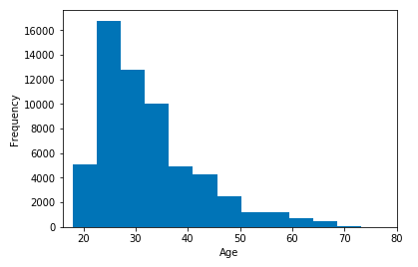
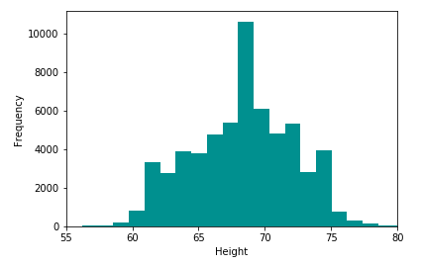
Exploring the Data
We plotted histograms to visualize age and height distribution.

Slide 4
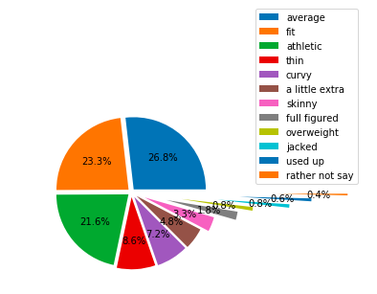
Exploring the Data
And here’s a pretty pie chart showing how people present their bodies. Why does OKCupid even ask people such a question? So last season.

Slide 5
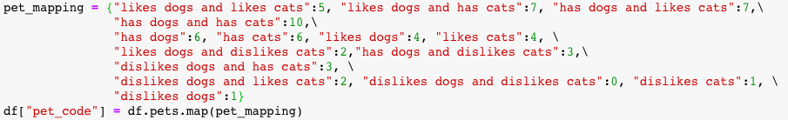
Transforming the Data
The dataset contains a lot of categorical data we can not work with and a bunch of personal essays we don’t really want to read. We transformed a few columns into numerical data using mapping. Like this:

Slide 6
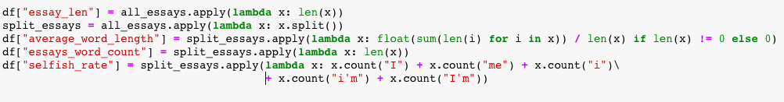
Dehumanizing the Essays
We put all the essays together and created new columns containing their total length, average word length, word counts, and the frequency of “I” and “me” appearing in them, assuming we’d be able to say something interesting about all those narcissists.

Slide 7
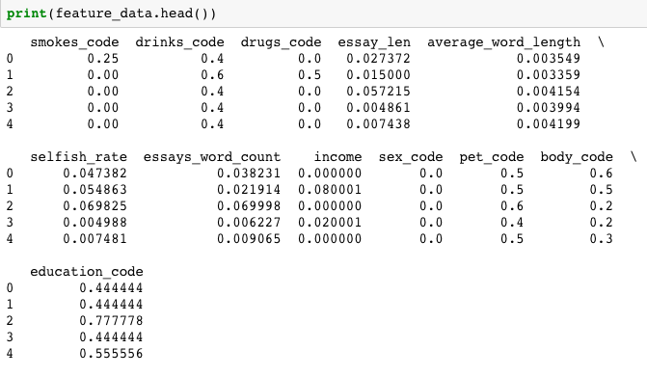
Normalizing the Data
We used the MinMaxScaler algorithm to arrange all the numerical data on the scale from 0 to 1.
Now it looks neat:

Slide 8
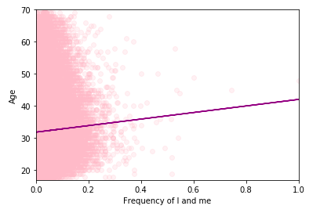
Applying Linear Regression
We tried to find out if we can predict a person’s age depending on how selfish they appear in their personal essays. We removed a few outliers from the age column—that 110 year old person probably wasn’t too serious when signing up for OKCupid. The “I”/”Me” frequency data also contained some significant outliers but we kept them. That’s what we’ve got.

Slide 9
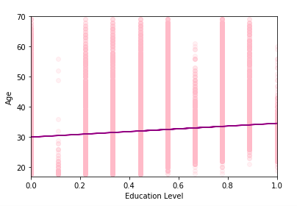
Applying Linear Regression
According to this line, everyone on OKCupid is somewhere between 32 and 40 y/o. We tried to remove especially selfish people from the dataset but it only made things worse: everyone was just 32. Trying to predict people’s income and education level based on their essay characteristics brought us nowhere. Most of the time the data wasn’t even linearly separable.
Same for age predictions. Other attempts
were useless and looked like this:

Slide 10
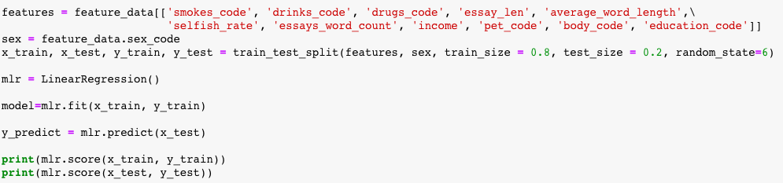
Applying Multiple Linear Regression
So, we decided to see if we can make more accurate predictions working with multiple features, such as people’s addictions, their love for pets, personal body images etc. We played with different characteristics trying to reach the highest possible mean squared error regression loss. We tried to predict people’s sex:

Slide 11
Applying Multiple Linear Regression
It didn’t really work out. The score was 0.04096982232070612 for the training set and 0.034952780889506374 for the test set. Considering that on OKCupid you can only be cisgender, that’s way worse than a random guess. Surprisingly, it’s easier to guess a person’s age (and there are people between 17 and 71)—0.0585/0.0475 accuracy score is two times better than random. We can tell if a person does drugs with 10% accuracy by looking at their essays, income, and other addictions, but that’s far away from accurate. Also, who would sincerely talk about drugs on a dating app? We shouldn’t let the machine judge these people.

Slide 12
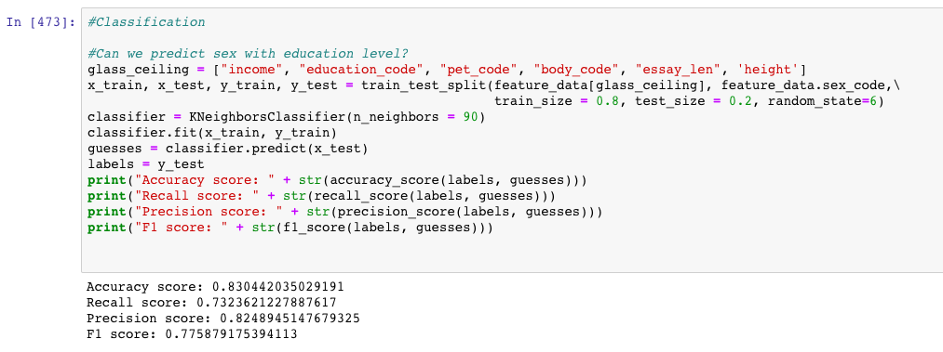
Applying K-nearest Neighbors Model
Well, that’s right, the machine performed so poorly trying to guess people’s sex because there were only two options and it thought gender was a spectrum. We tried to show the computer the world like dating apps see it and gave it labels to play with instead of numbers. Here’s what we got:

Slide 13

Beautiful!
The machine has successfully learned that many males are tall and females are not as tall and get paid less for doing the same work. But this is still impossible:

Slide 14

Thanks Codecademy!

